Slide 1

Business Analytics II (BIS 244 – Chapter 5)
BIS 244 – Fall 2022 – Dr. Davoodi

Slide 2

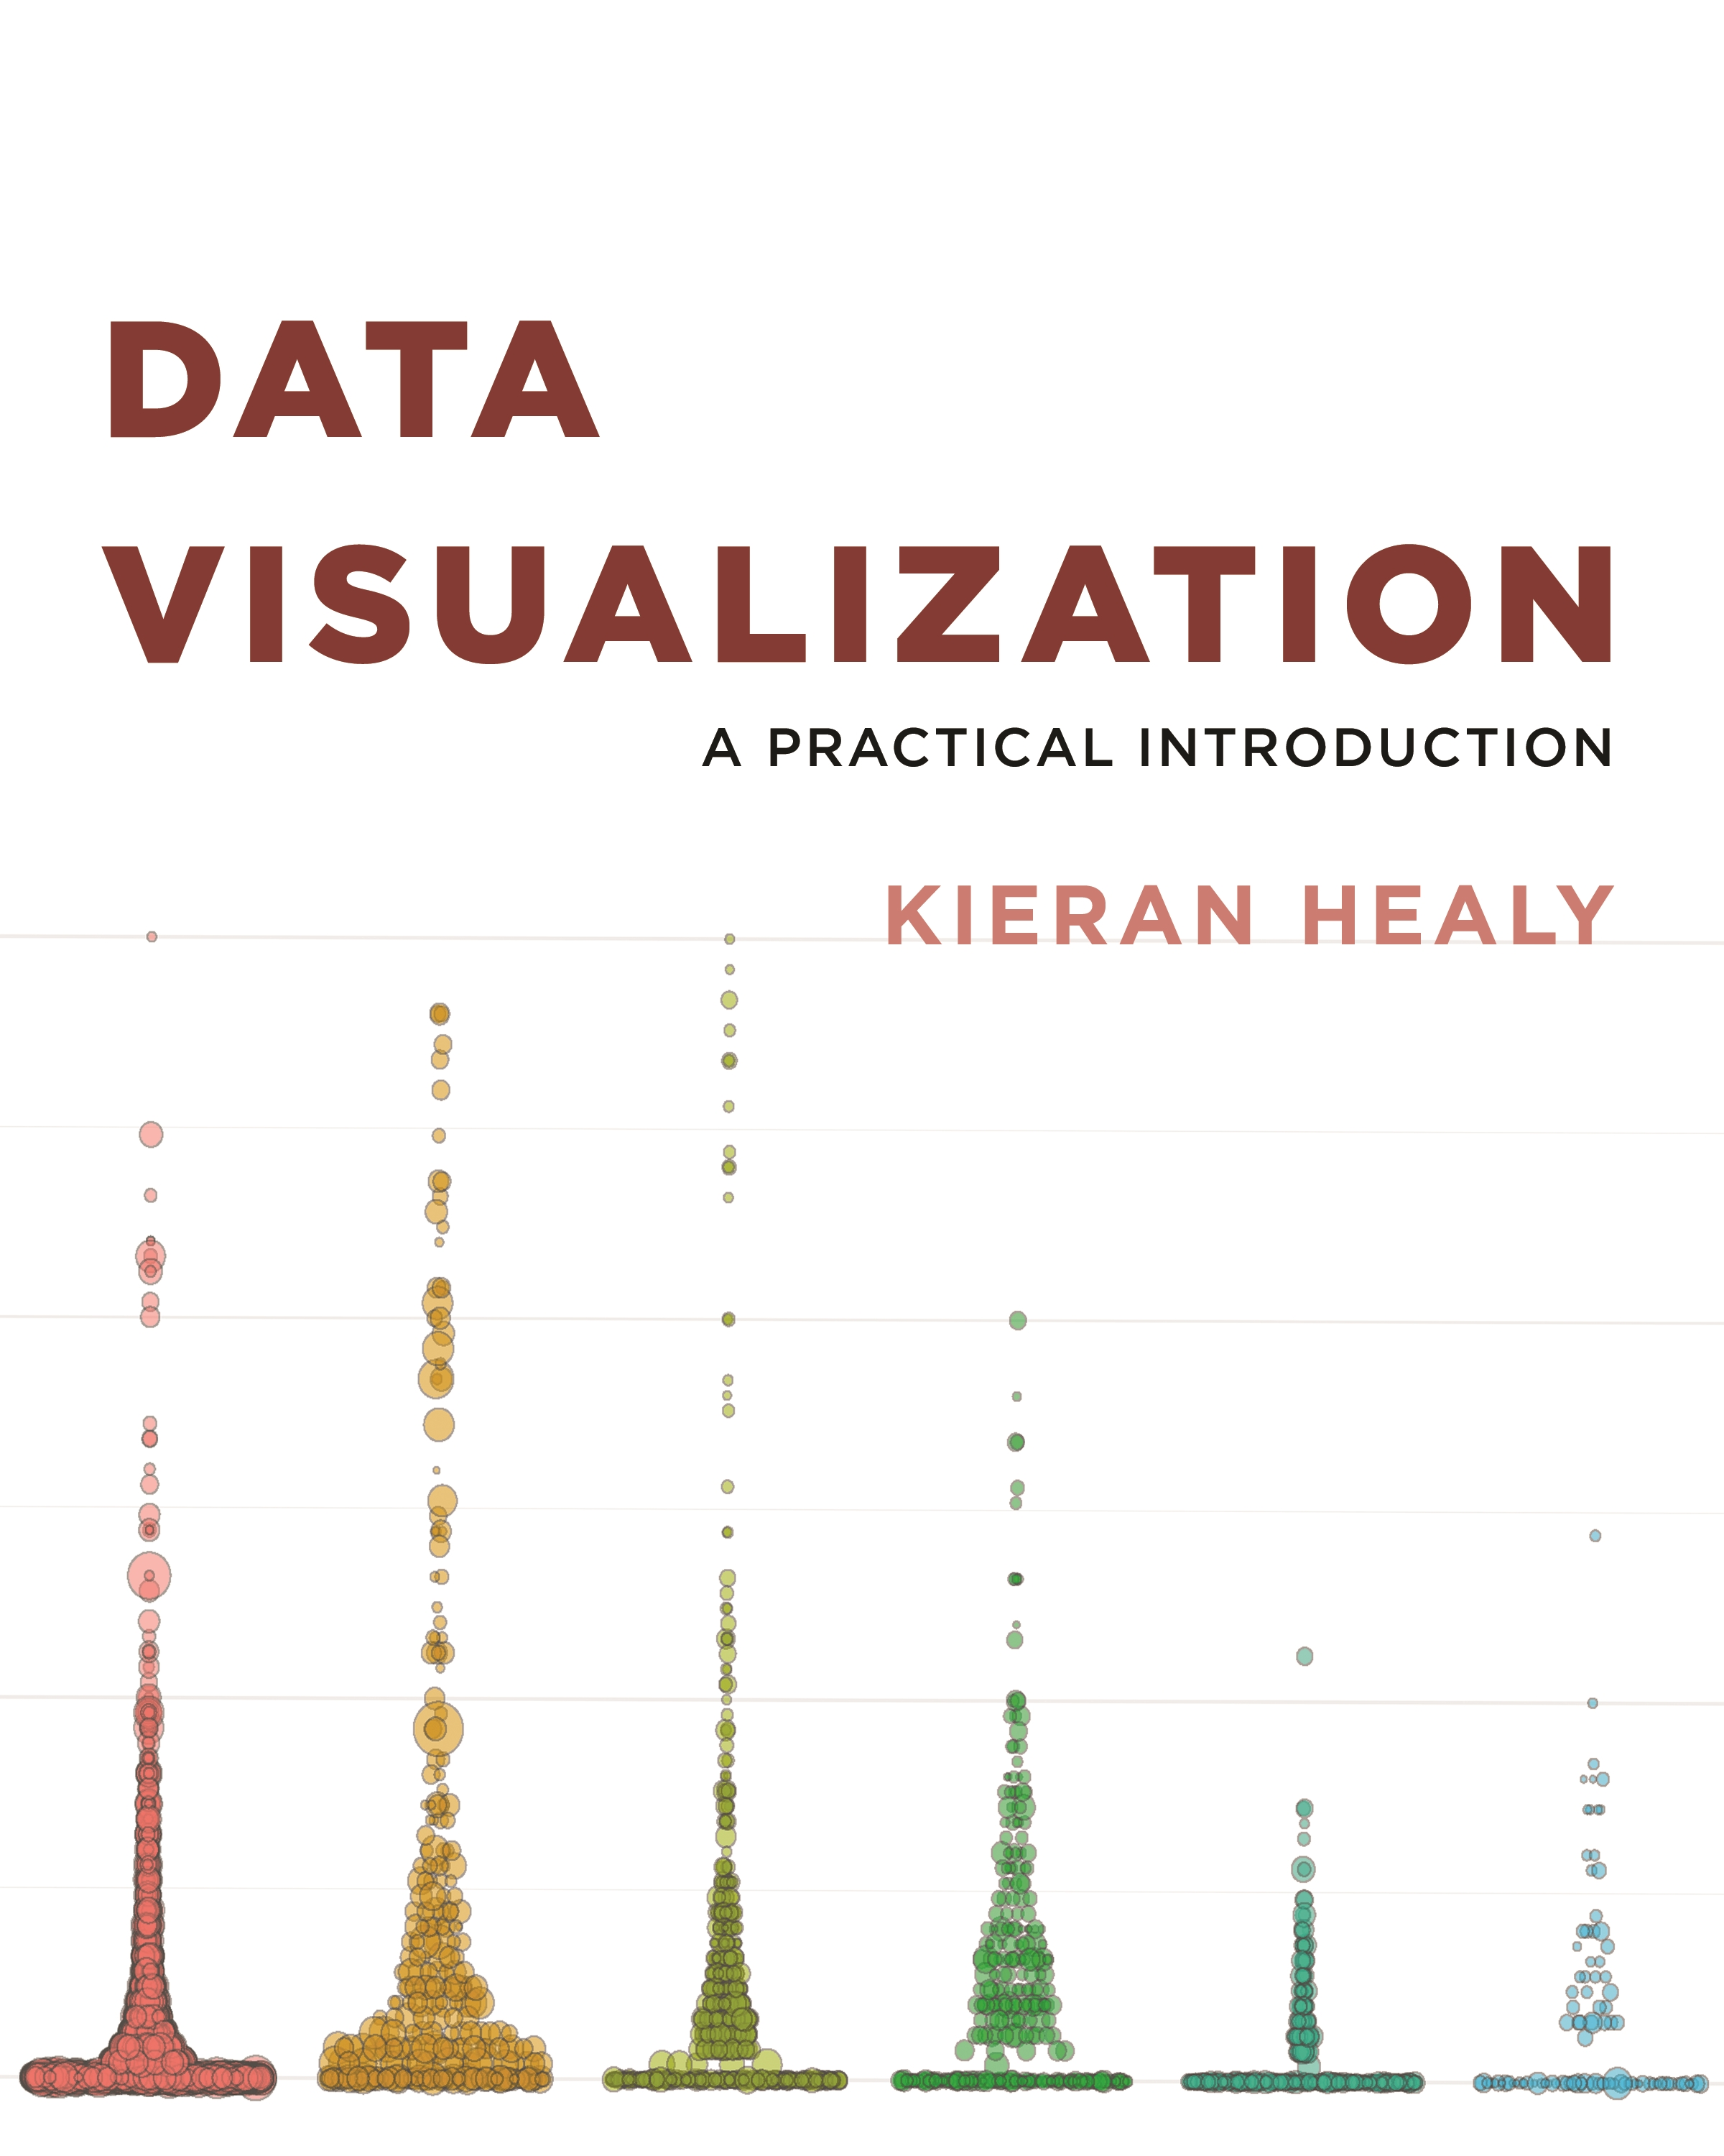
Chapter 5: Graph Tables, Add Labels, Make Notes

Slide 3
Chapter 5
Chapter 5 focus: expanding the range of things you can do with ggplot.
How to transform data before we send it to ggplot
Refer to chapter 4, ggplot’s geoms will often summarize data for us.
Often it’s better to get things into the right shape before we send anything to ggplot.
Learn how to use some functions to select, group, summarize, and transform our data.
Chapter 4 Part 1:
Dividing data techniques
Chapter 4 Part 2:
Grouping data techniques

Slide 4
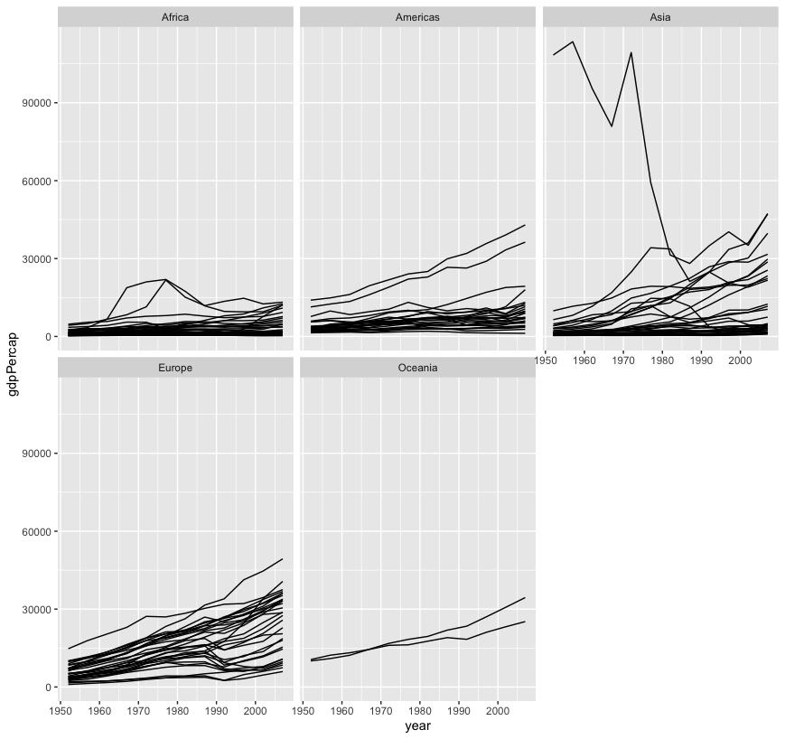
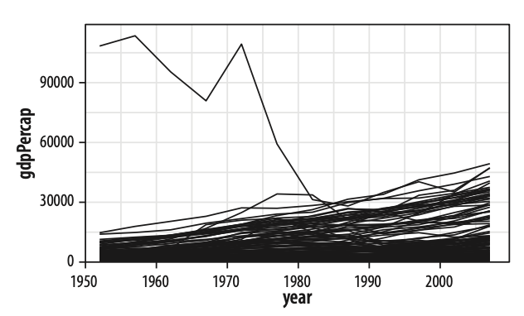
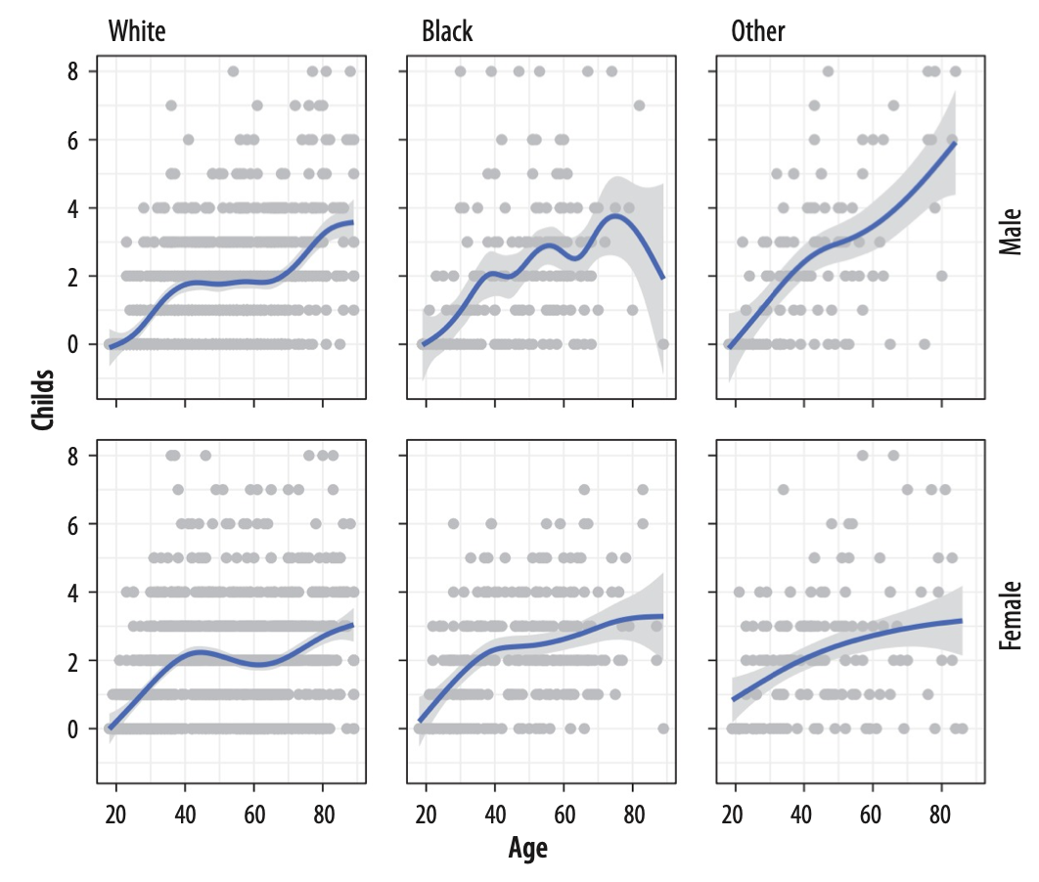
Chapter 4 Review
facet_grid()
facet_wrap() to split our plot by the third variable
facet_grid(): Facet with two variables
Faceting on two categorical variables.
Each panel plots the relationship between age and number of children, with the facets breaking out the data by sex (in the rows) and race (in the columns).
Main variables: Age and Number of children
Faceting variables: Sex (row) and Race (column)

Slide 5
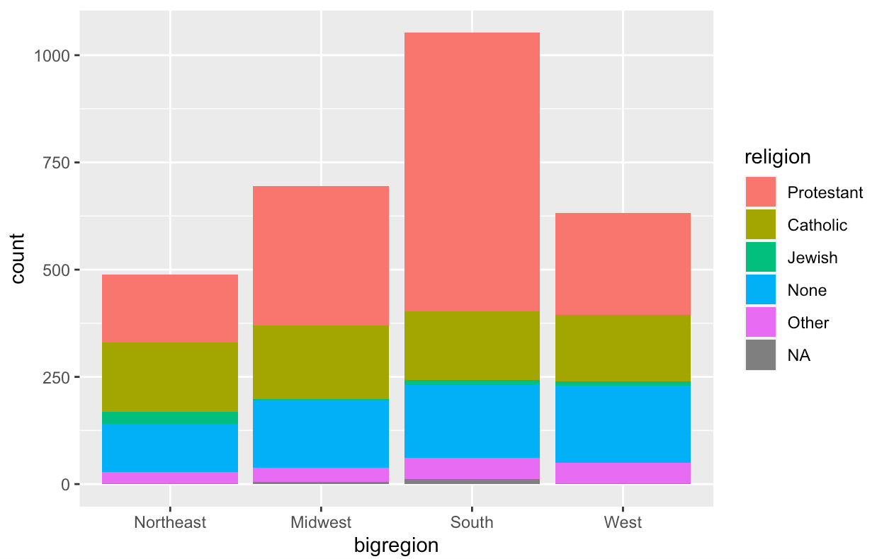
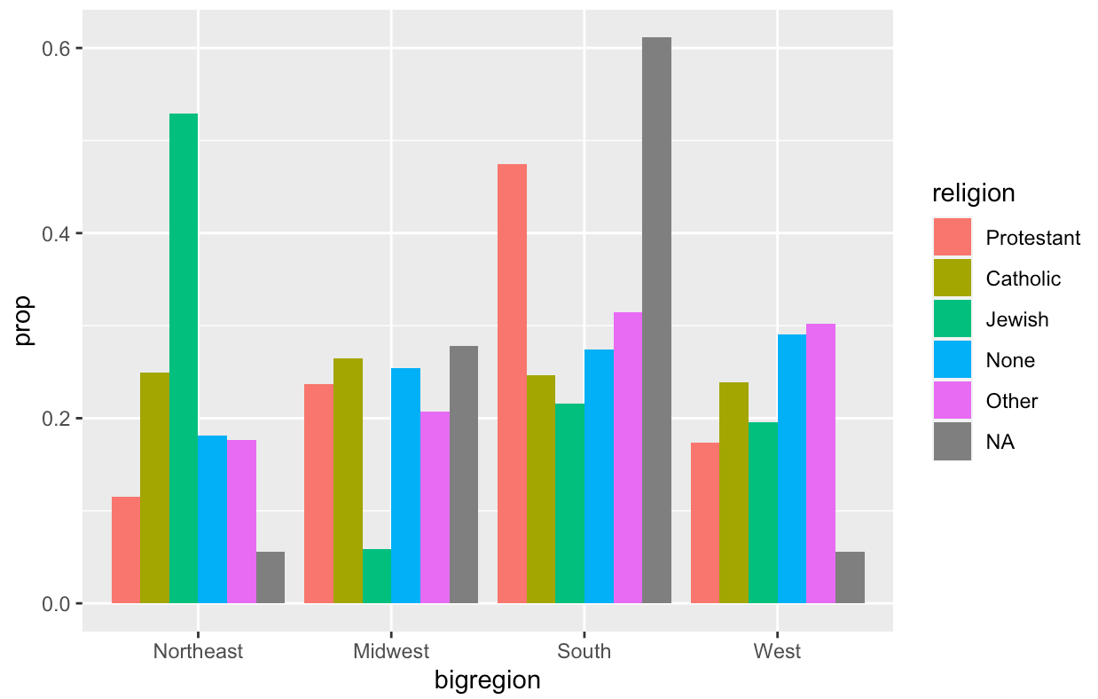
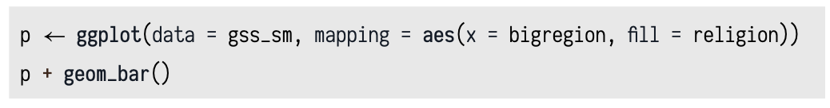
Chapter 4 Review
If we want bars by religion in each bigregion,
Default: x = bigregion, fill=religion
When we just wanted the overall proportions for one variable, we mapped group = 1 to tell ggplot to calculate the proportions with respect to the overall N.

Slide 6
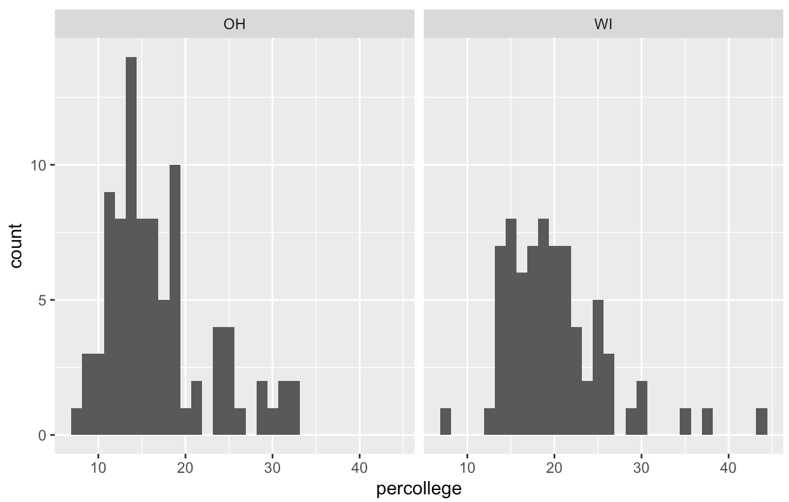
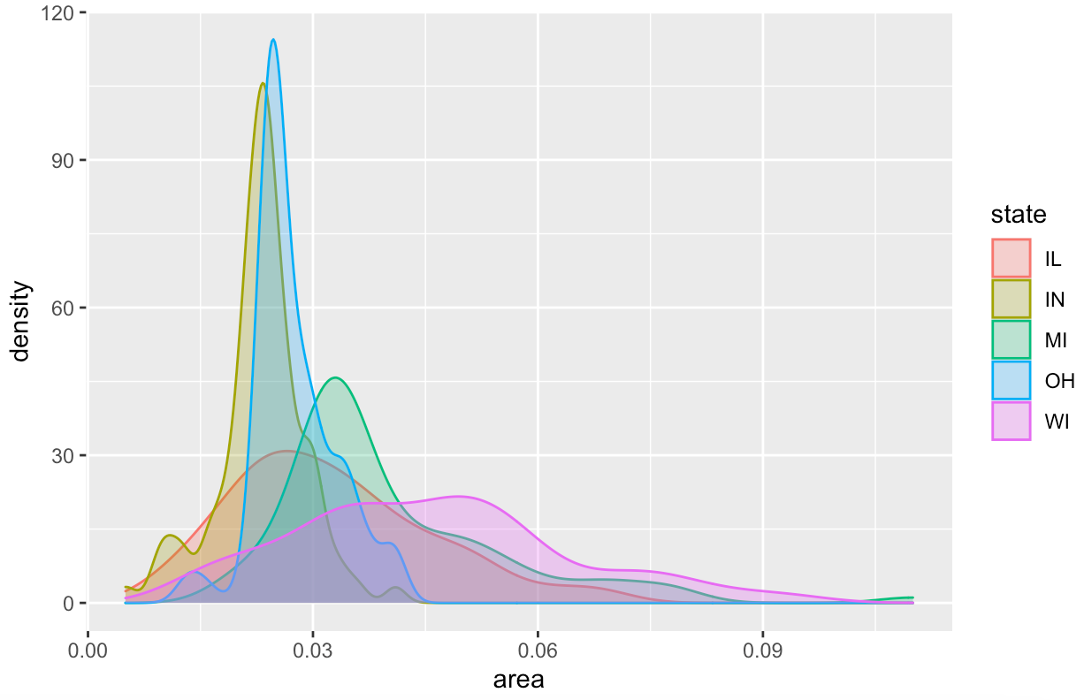
Chapter 4 Review
While histograms summarize single variables, it’s also possible to use several at once to compare distributions.
When working with a continuous variable, an alternative to binning the data and making a histogram is to calculate a kernel density estimate of the underlying distribution.

Slide 7
5.1 Use Pipes to Summarize Data
In chapter 4, we start summarizing our data
Recall “bar chart by religion in each bigregion”,
Count chart or frequency chart done in chapter 4,

Slide 8
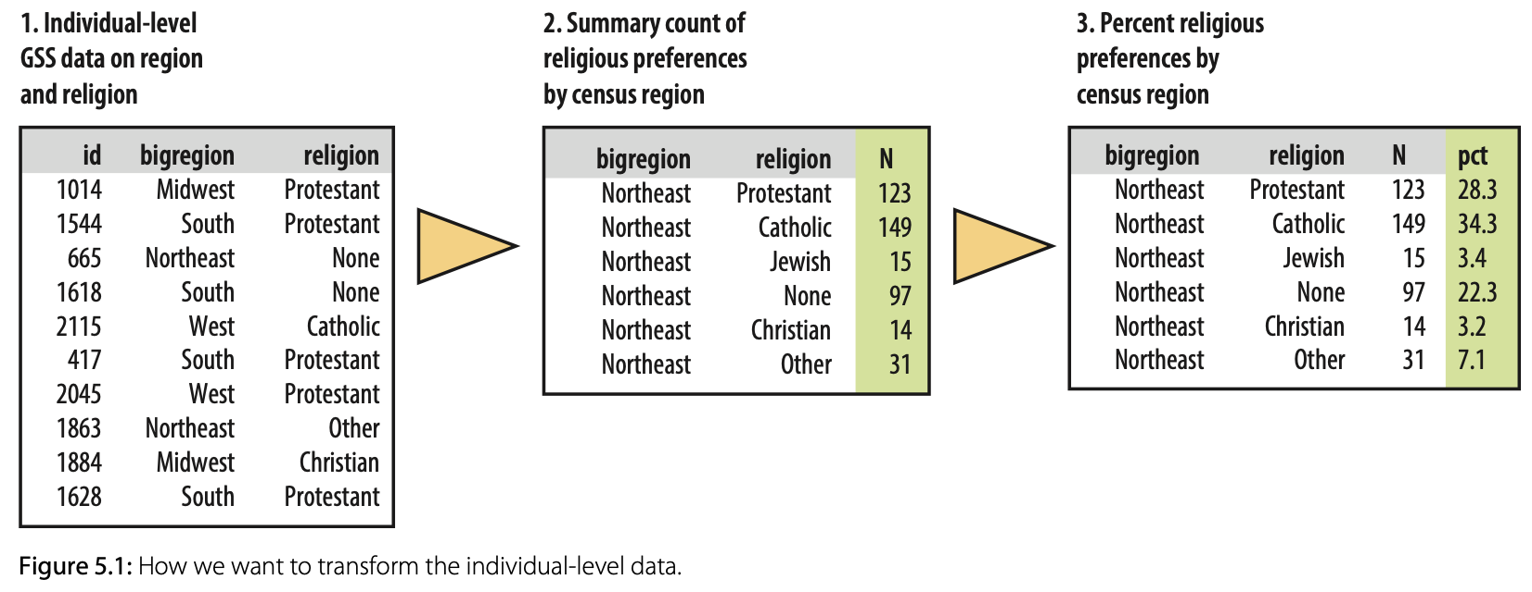
5.1 Use Pipes to Summarize Data
Our goal is a summary table with percentages of religious preferences grouped within region.

Slide 9
5.1 Use Pipes to Summarize Data
%>%: Pipe operator
Think of the %>% operator as allowing us to start with a data frame and
perform a sequence or pipeline of operations to turn it into another, usually smaller and more aggregated, table.

Slide 10
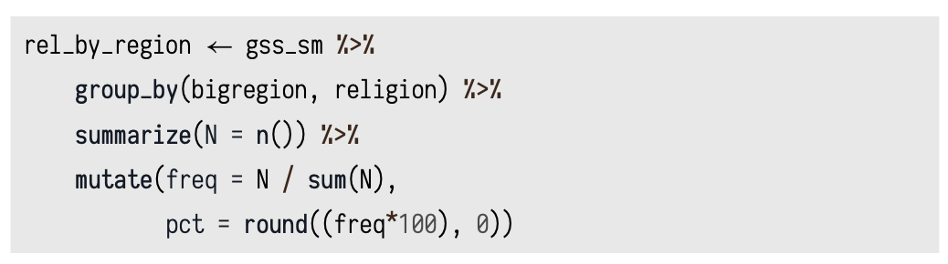
5.1 Use Pipes to Summarize Data
Our goal is a summary table with percentages of religious preferences grouped within region.
Healy_CH5.R

Slide 11
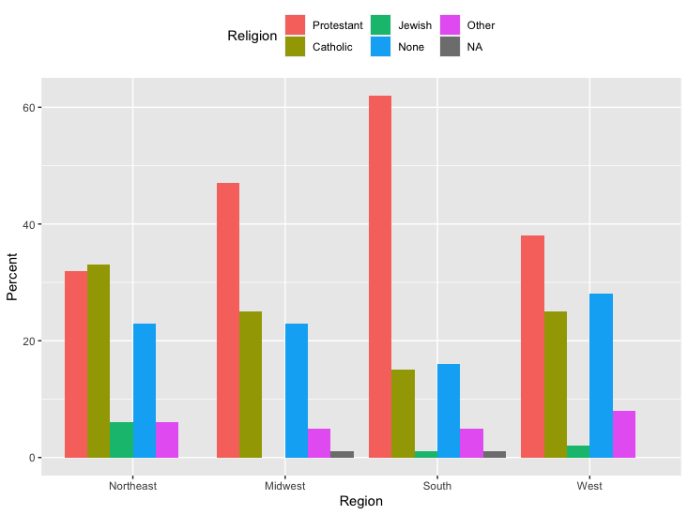
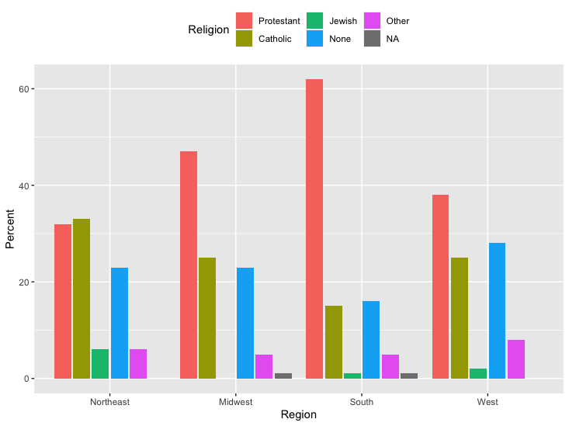
5.1 Use Pipes to Summarize Data
Plotting our summarization table
Working directly with percentage values in a summary table
Plot the percentage of each religion in each bigregion directly

Slide 12
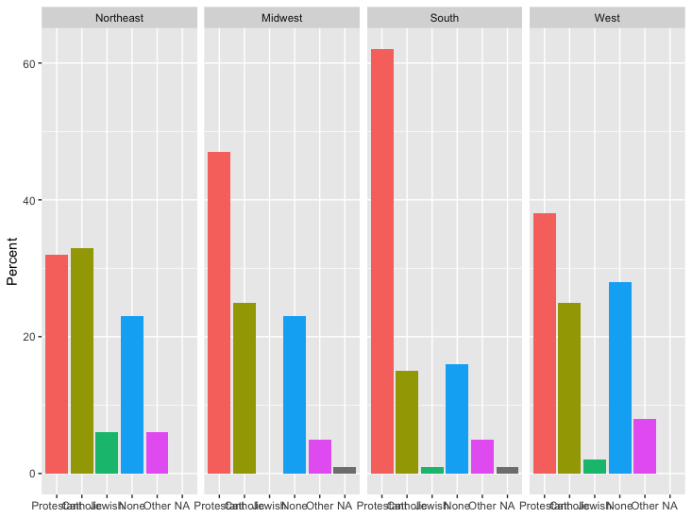
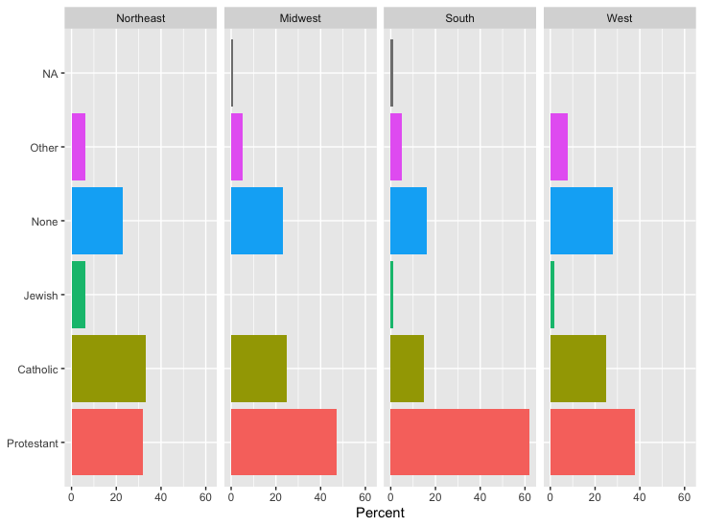
5.1 Use Pipes to Summarize Data
Plotting our summarization table
Plot the percentage of each religion in each bigregion directly
Place graphs for each region side-by-side (Facet_grid and coord_flip)

Slide 13
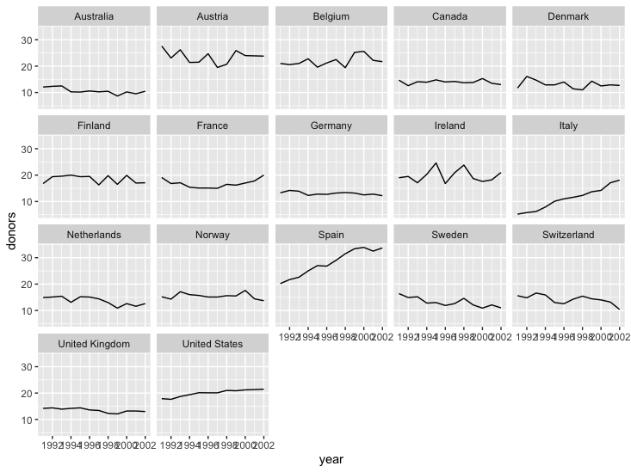
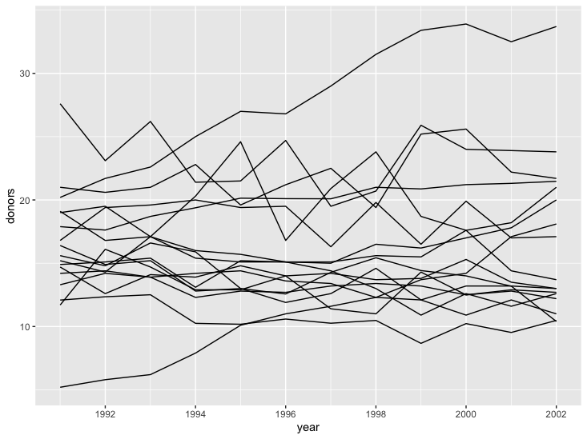
5.2 Continuous Variables by Group or Category
A new dataset named “organdata”
Use pipeline operator to use the first six columns
Use bar chart to show the data based on donors over years for each country

Slide 14
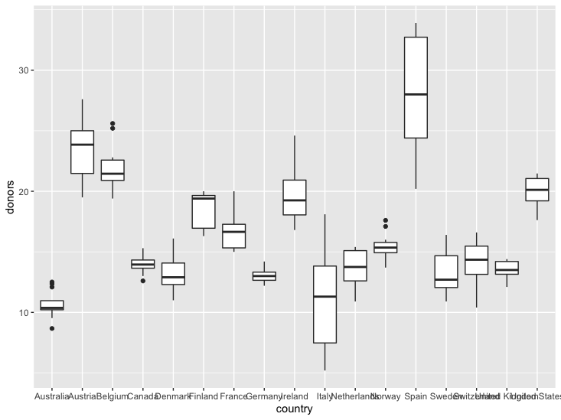
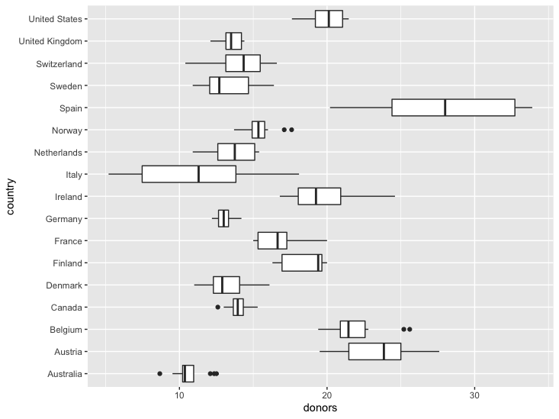
5.2 Continuous Variables by Group or Category
How to measure the variation in the number of donors over years for each country?
BOXPLOT

Slide 15
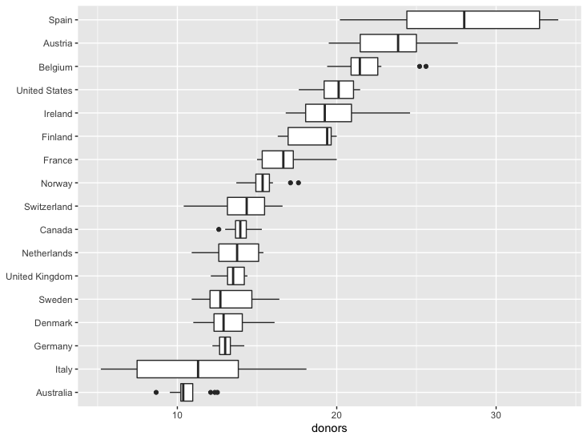

5.2 Continuous Variables by Group or Category
Reordering the country listings by "donors" mean values

Slide 16
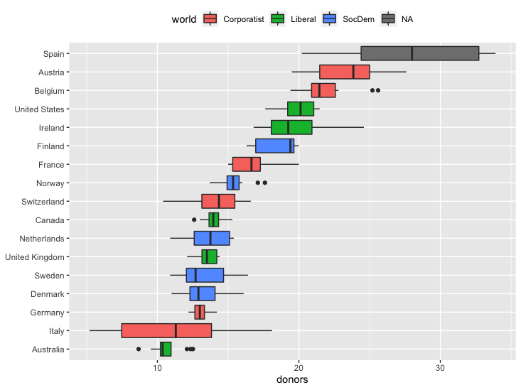
5.2 Continuous Variables by Group or Category
Reordering the country listings by "donors" and colors using "fill" parameter

Slide 17
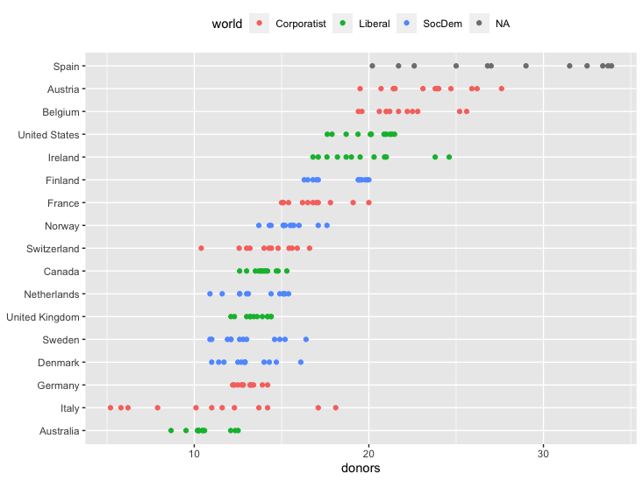
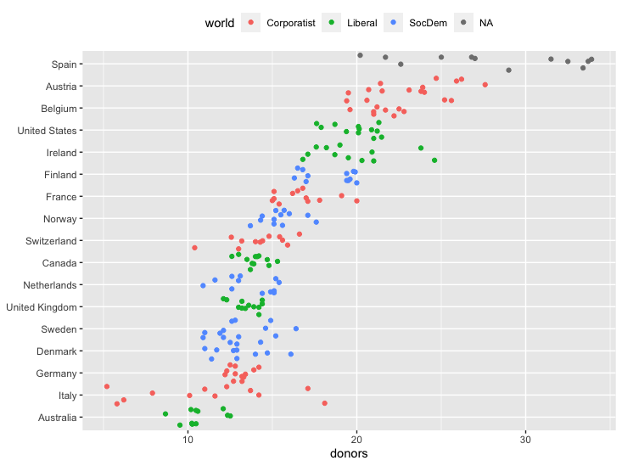
5.2 Continuous Variables by Group or Category
Use other charts instead of Boxplot
geom_point: Scatter Plot
geom_jitter: Jitter Plot

Slide 18
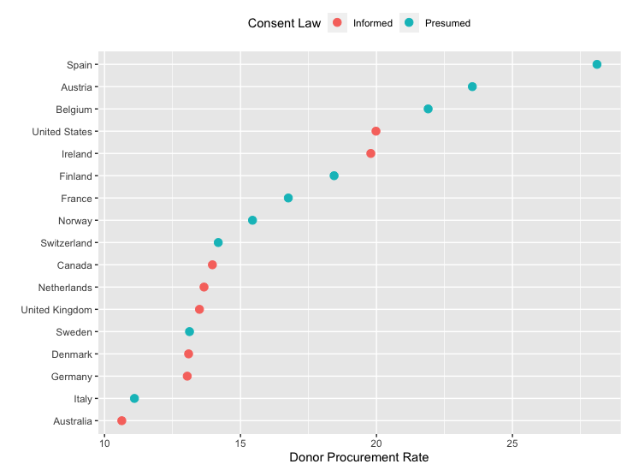
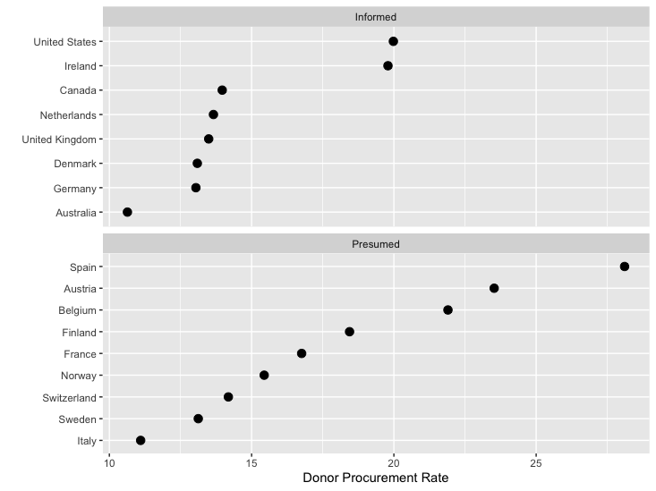
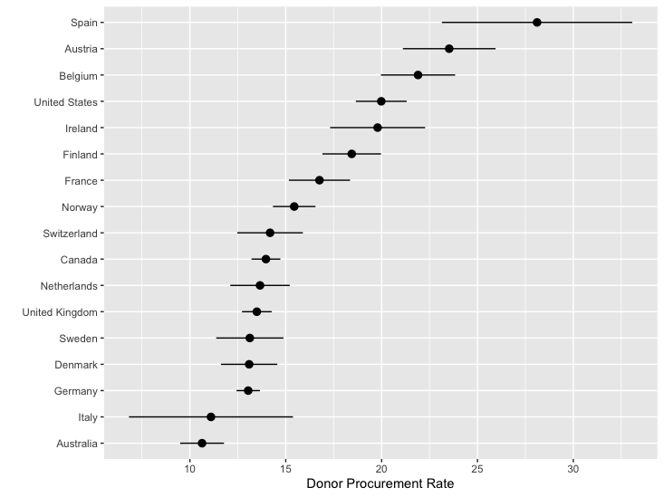
5.2 Continuous Variables by Group or Category
Use summarize function to create new columns for grouped dataframe
Mean and standard deviation for all numerical columns
Plot some columns
Facet them
….

Slide 19
Summary
In this lecture (First part of chapter 5), we learned how to use
pipe operator to pass a dataframe or tibble to a function
summarize function to create a new dataframe
mutate function to create new columns
ggplot functions like geom_col, geom_boxplot, coord_flip, geom_jitter, and geom_pointrange to visualize some data

